Slide 1
Assignment 1
Sept. 26, 2024

Slide 2
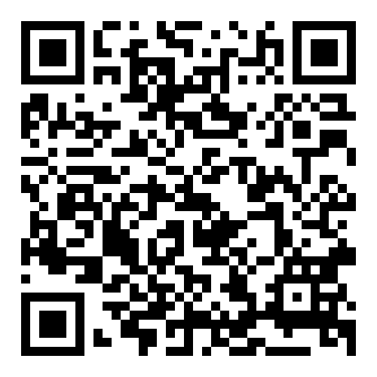
https://www.cs.nycu.edu.tw/~lhyen/np/ass1/np24f_ass1.html
Local Testing Servers:
140.113.235.236
Final Testing Servers:
140.113.207.75

